Slide 1
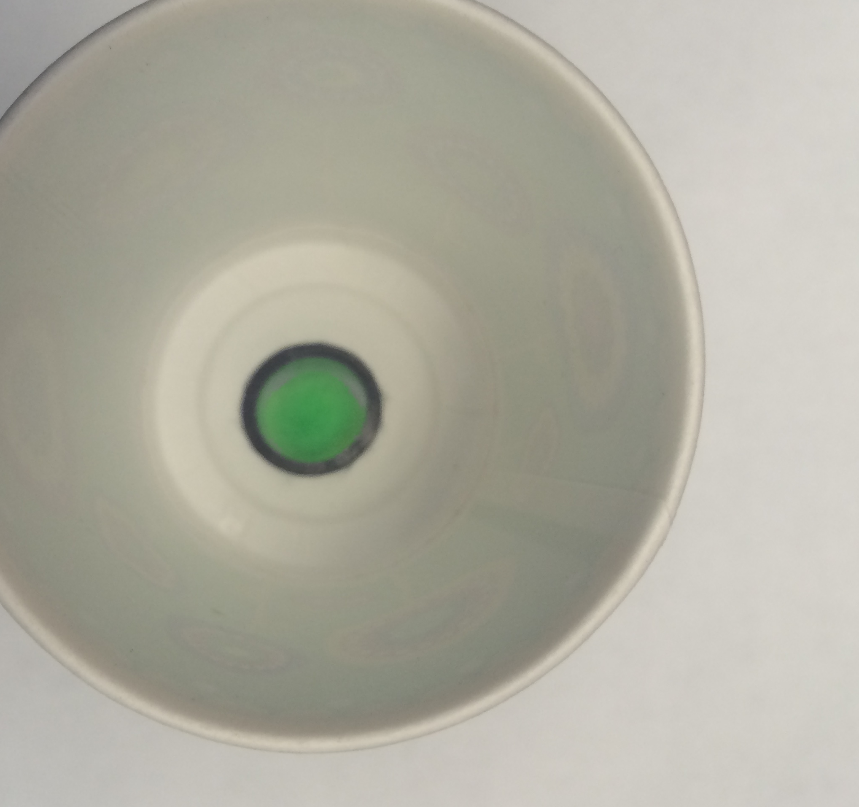
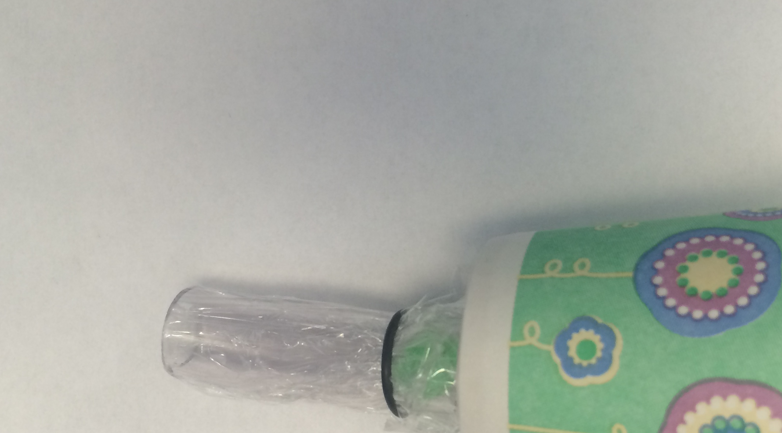
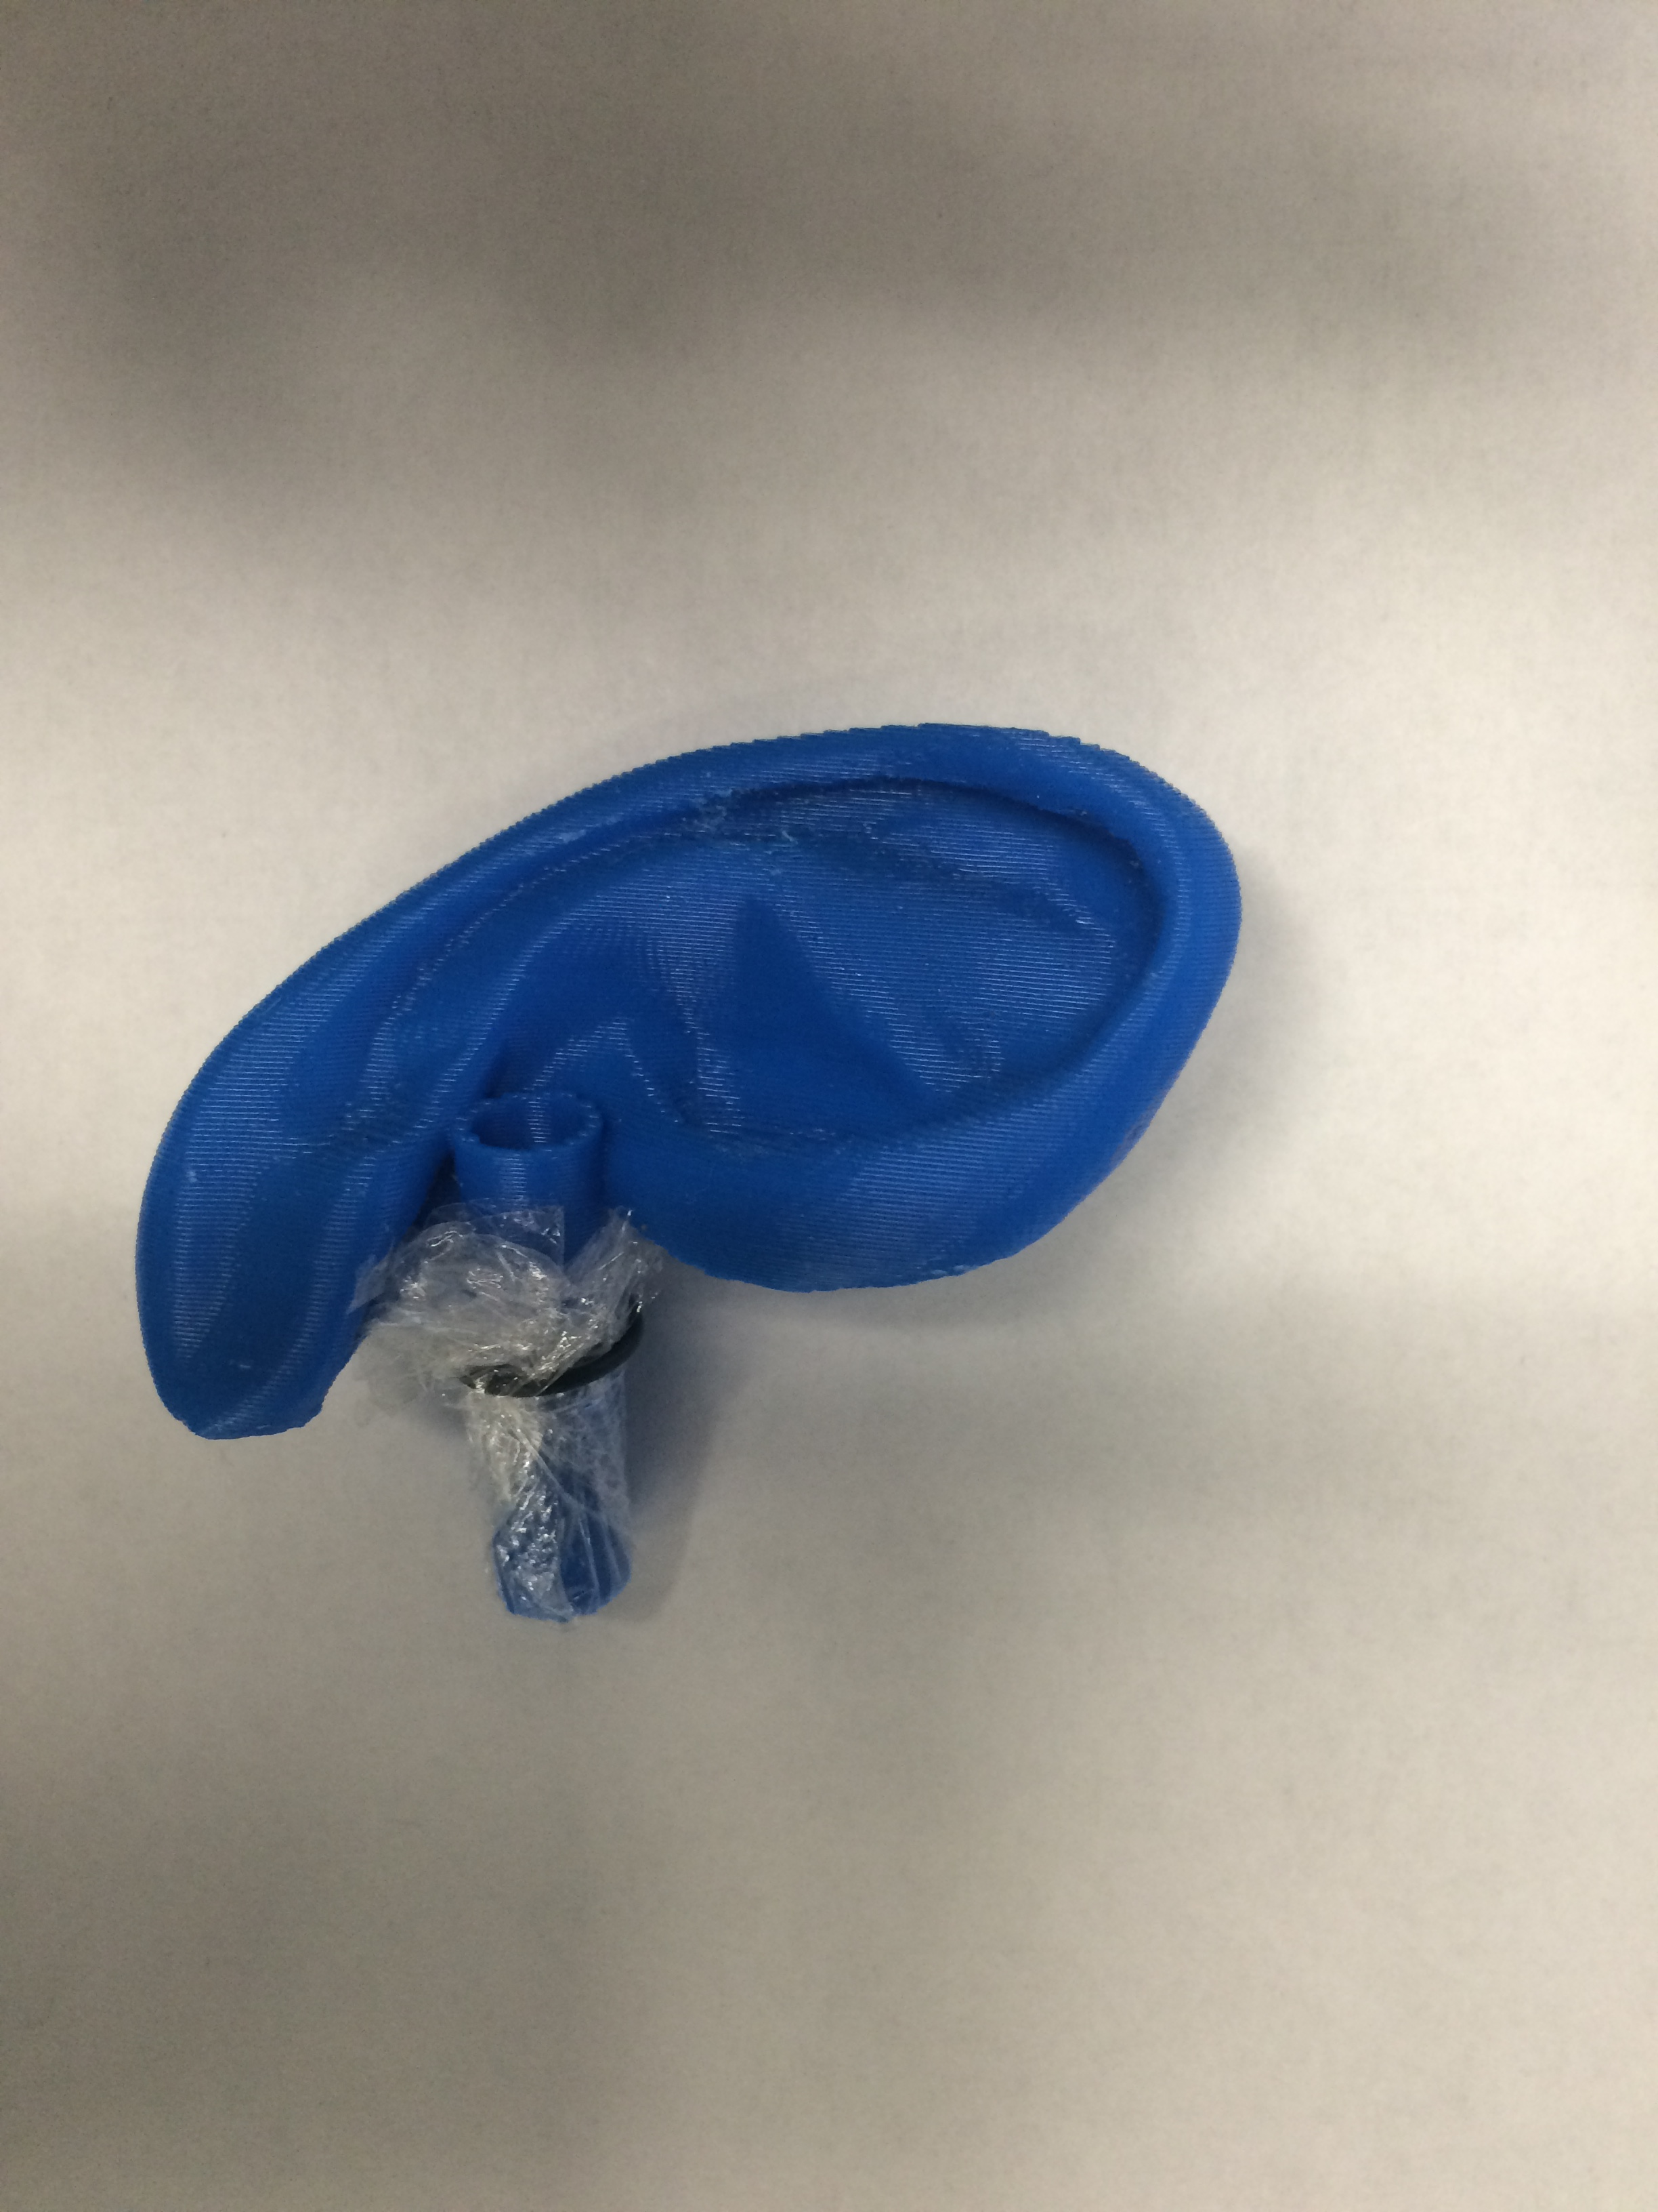
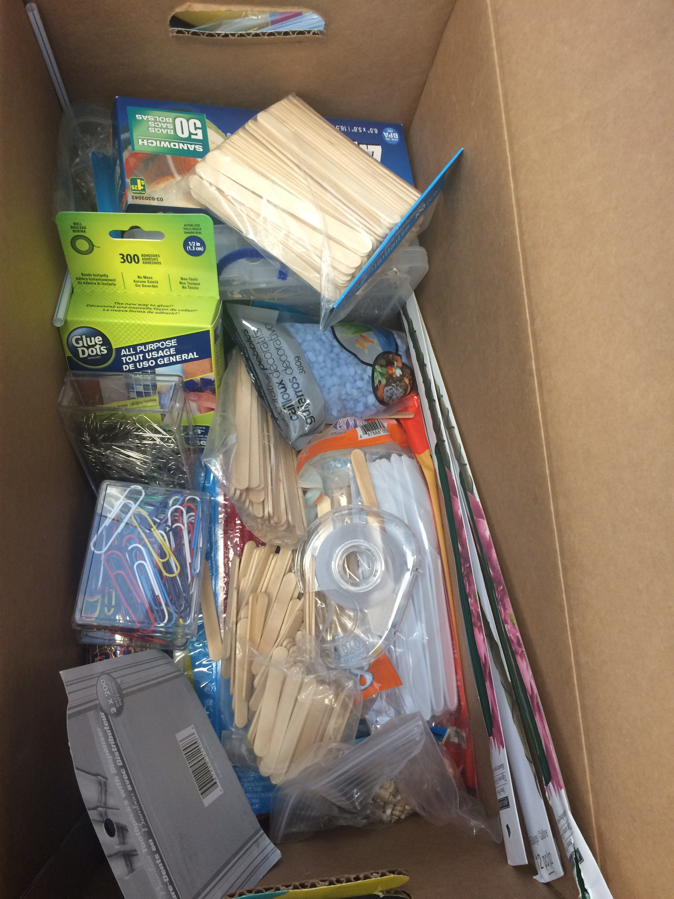
Using a Multidisciplinary Team-Based Challenge to Promote Brainstorming and Prototyping of Medical Devices
Arushri Swarup^{1,2}, Vicki Komisar^{1,3}, J. Christopher Bouwmeester¹
1 Institute of Biomaterials and Biomedical Engineering, University of Toronto; 2 The Hospital for Sick Children, Toronto; 3 Toronto Rehabilitation Institute – University Health Network
Objectives
Expose students from engineering and life sciences to a brainstorming and prototyping exercise where the students can:
Apply brainstorming techniques
Recognize important steps in medical device design processes
Produce a working prototype
Evaluate alternative designs
Verify a preferred solution
Results: students learned more about bio and 6-3-5 and they ranked 6-3-5 the best after the exercise
Prototyping Challenge where students brainstormed and prototyped a solution to remove various objects (e.g. gel beads, silicone putty ear plugs, miniature shells, fuzzy pompoms, etc.) stuck inside a model ear canal without puncturing the ear drum
Reviewed the brainstorming techniques and assigned one to each group
Groups were given access to a selection of hand tools (e.g. DremelⓇ tools, wire cutters, scissors, glue guns, tape, etc.) and easy-to-use construction materials (e.g. wire, springs, balsa wood, wood craft sticks, floral foam, straws, etc.) to create prototypes to remove the foreign objects
Each group was given a low fidelity ear model to start with, see Figure 1A and once students had a working prototype using the low fidelity model, they were given a smaller scale 3D printed model, where the ear canal is 5mm in diameter
After two hours, students were able to realize their brainstorming ideas into quick, easy-to-construct prototypes
Prototypes were showcased to the class after the challenge and this led to discussion on how the brainstorming technique influenced the devices they created, which allowed the class to understand how each brainstorming technique influenced the resultant prototype
Pre-Prototyping Challenge
Lectures introduced four brainstorming techniques:
6-3-5 method
Biological inspiration
Mind Mapping
“How Might We…?”
CONCLUSION
Setup the table with all the materials that you could use to make the prototypes
Less words – objectives are good
Discussion – they understood bio better
Future work and limitations – should have done a jigsaw style – every member of the group is assigned a different brainstorming technique and then they consolidate with other groups’ members and then they go bak to their group
Test it on a human sized head
Make it flow chart style
REFERENCES
Notes:
3’X5’

